Slide 1


OPENSHIFT ARCHITECTURE

Slide 2





YOUR CHOICE OF INFRASTRUCTURE
2 OPENSHIFT TECHNICAL OVERVIEW

Slide 3
NODES RHEL INSTANCES WHERE APPS RUN
3 OPENSHIFT TECHNICAL OVERVIEW

Slide 4








APPS RUN IN CONTAINERS
4 OPENSHIFT TECHNICAL OVERVIEW

Slide 5


PODS ARE THE UNIT OF ORCHESTRATION
5 OPENSHIFT TECHNICAL OVERVIEW

Slide 6
MASTERS ARE THE CONTROL PLANE
6 OPENSHIFT TECHNICAL OVERVIEW

Slide 7
API AND AUTHENTICATION
7 OPENSHIFT TECHNICAL OVERVIEW

Slide 8
DESIRED AND CURRENT STATE
8 OPENSHIFT TECHNICAL OVERVIEW

Slide 9

INTEGRATED CONTAINER REGISTRY
9 OPENSHIFT TECHNICAL OVERVIEW

Slide 10


ORCHESTRATION AND SCHEDULING
10 OPENSHIFT TECHNICAL OVERVIEW

Slide 11

PLACEMENT BY POLICY
11 OPENSHIFT TECHNICAL OVERVIEW

Slide 12
AUTOSCALING PODS
12 OPENSHIFT TECHNICAL OVERVIEW

Slide 13





SERVICE DISCOVERY
13 OPENSHIFT TECHNICAL OVERVIEW

Slide 14

PERSISTENT DATA IN CONTAINERS
14 OPENSHIFT TECHNICAL OVERVIEW

Slide 15




ROUTING AND LOAD-BALANCING
15 OPENSHIFT TECHNICAL OVERVIEW

Slide 16



ACCESS VIA WEB, CLI, IDE AND API
16 OPENSHIFT TECHNICAL OVERVIEW

Slide 17
OPENSHIFT ARCHITECTURE
17 OPENSHIFT TECHNICAL OVERVIEW

Slide 18
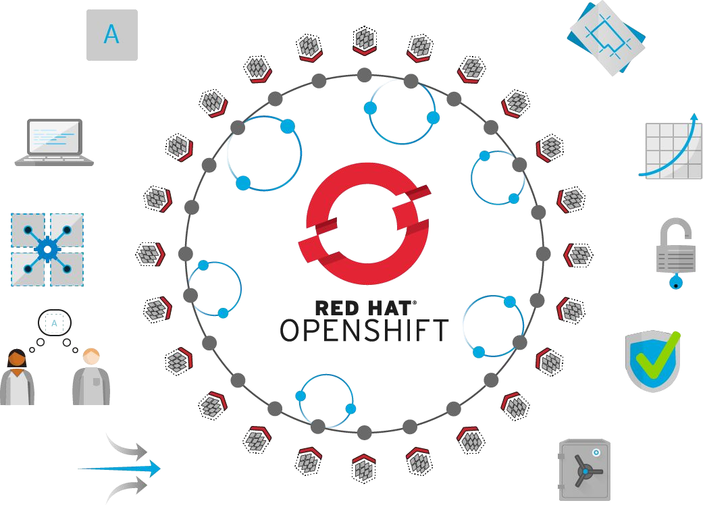
Standards-based
Self-Service
Multi-language
Web-scale
Automation
Open Source
Collaboration
Enterprise Grade
Multi-tenant
Secure
18 OPENSHIFT TECHNICAL OVERVIEW

Slide 19
Thank You

